Slide 1
Lending Club Case Study
Upgrad lending club case study project

Slide 2
Table of Contents
The Problem
Domain, Context and Problem Statement
Decision Matrix
Dataset understanding
Assumptions
Challenges deep dive
Approach
Key Columns
Excluded Columns
Data preprocessing
Analysis (Univariate, Bivariate, Multivariate)
Inferences
Result
Recommendations
Team

Slide 3
The problem
Context
The lending company faces largest amount of financial loss due to loan defaults. The amount lost by the lender when a borrower defaults is called credit loss. A loan is called to be defaulted when borrower does not return the amount fully/partially. These loans are also called to be Charged Off. Borrowers can easily access lower interest rate loans through a fast online interface. Company approves loan based on its current risk assesment of tendency of the loan getting default.
Company wants to reduce the loss due to loan defaults by rejecting loans which are likely to be default. However risk associated with this rejection decision is to lose a loan which otherwise would have been fully paid. Company is looking improve their ability to more accurately understand the lieklyhood of a loan application getting default if approved.
Problem statement
The company has provided few years of data which consists of various attributes of loans which where approved and are etiher fully paid or charged off (defaulted) or is currently running.
We need to understand the influences of loan and consumer atributes towards tendency to default and indentify variables which are strong indicators of default.
The company can utilise this knowledge for its risk assessment to reduce the loss.

Slide 4
Assumptions
loan_status is “Current” is not useful.
Binning with uniform intervals
Monotonous column, ids (such as id, member_id) columns are not useful.
Free form columns like description , title are not influensive to result.
Atributes created after loan approval are not considered for analysis

Slide 5
Approach

Slide 6
Stages
Analysis of the dataset
Univariate
Segmented Univariate
Bivariate
Multivariate analysis
Drop Null Columns
Drop Current loan_status
Handle Missing
Data Cleaning
Standardization
Analysis
Results
Standarized Column values:
Percentage
Date
Parsing Dates where years going back to 1946.
Conclusions,Inferences and Recommendations

Slide 7
Key Column Selection
Customer Demographics
Annual Income (annual_inc)
Home Ownership (home_ownership)
Employment Length (emp_length)
Debt to Income (dti)
State (addr_state)
Loan Attributes
Loan Amount (loan_amt)
Grade (grade)
Term (term)
Loan Date (issue_date)
Purpose of Loan (purpose)
Verification Status (verification_status)
Interest Rate (int_rate)
Installment (installment)
Public Records (public_rec)
Public Records Bankruptcy (public_rec_bankruptcy)
Derived Attributes
Range bins for selected continuous data types
Year and Month columns for selected date types.
- Selected above column based on the market research indicating their influences on loan default.

Slide 8
Exclusion Made
Columns
Columns containing NA values only
Columns containing single unique value
Non business columns like ids, title, desc, url
Rows
“Current” loan_status
Rows for low caridnality dimensions
Rows corresponding to outliers for various continous attributes.

Slide 9
Selection of Analysis Type
Frequency bar plot for categorial data
Summary analysis of continuous data
Scatter Plot between two continuous data type
Bar Plot for analysis for a categorial data segmented by loan_status
Bar Plot for Bivariate Analysis between categorial data
Box Plot for bivariate or segmented univariate with continuous data
Heatmap for multivariate analysis

Slide 10
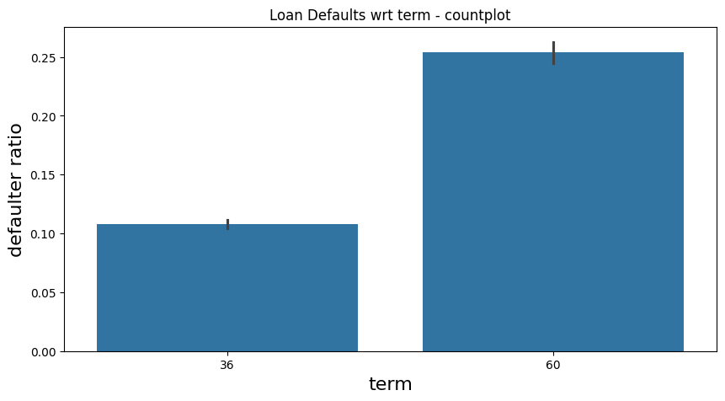
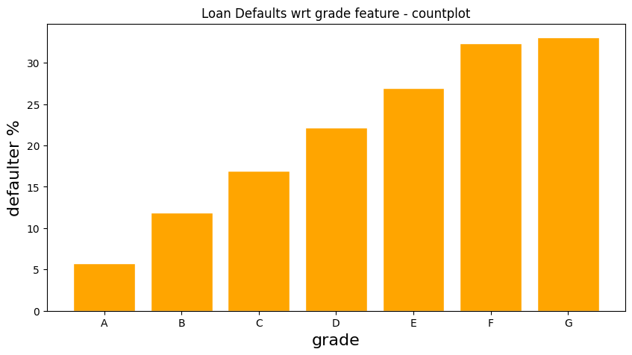
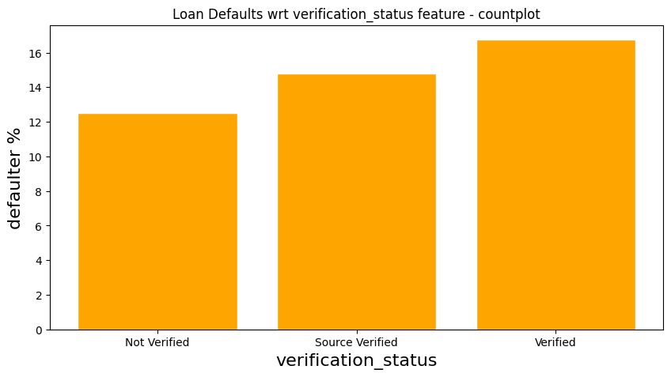
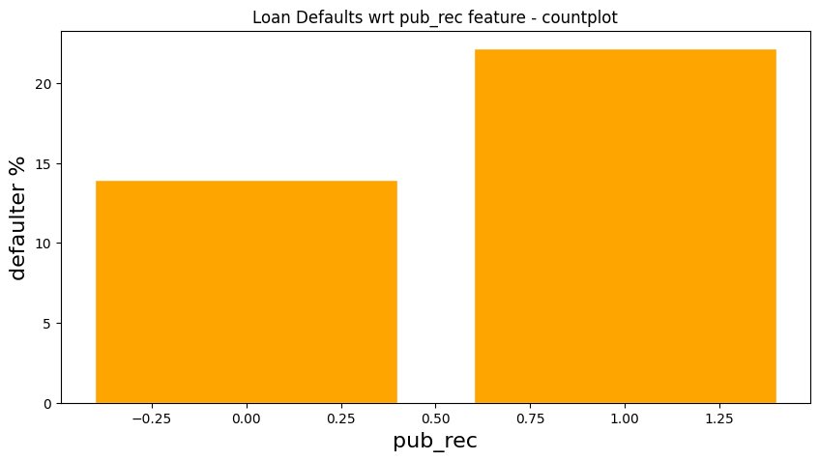
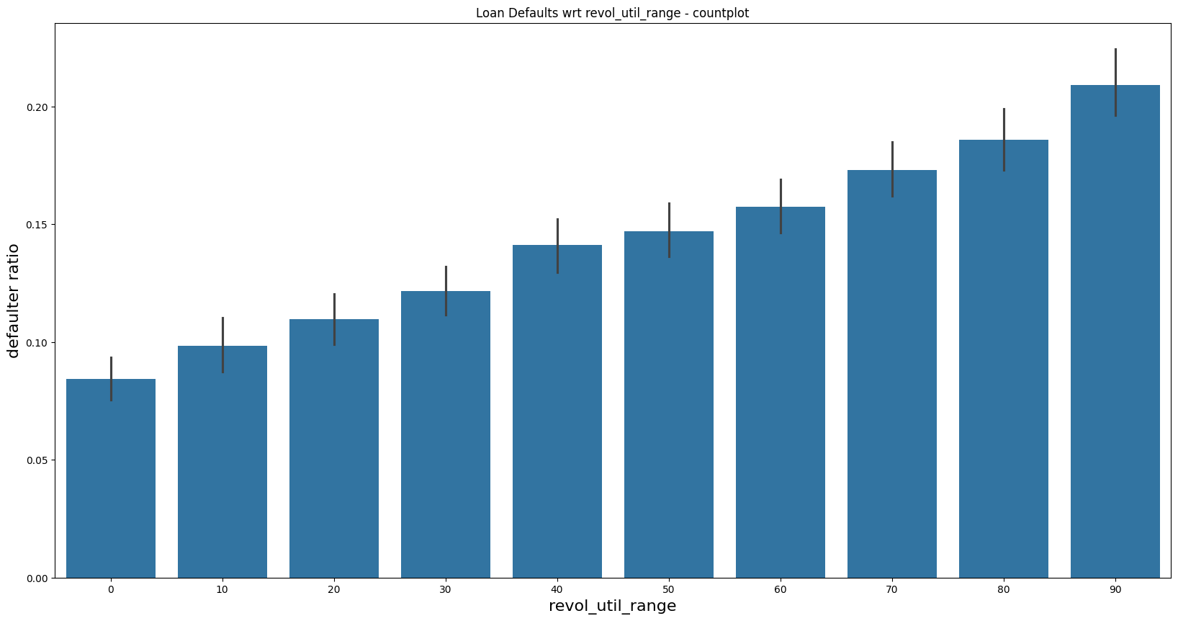
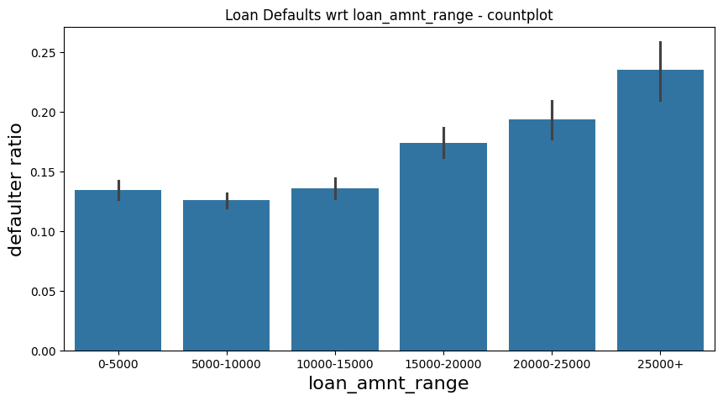
Univariate Analysis

Slide 11
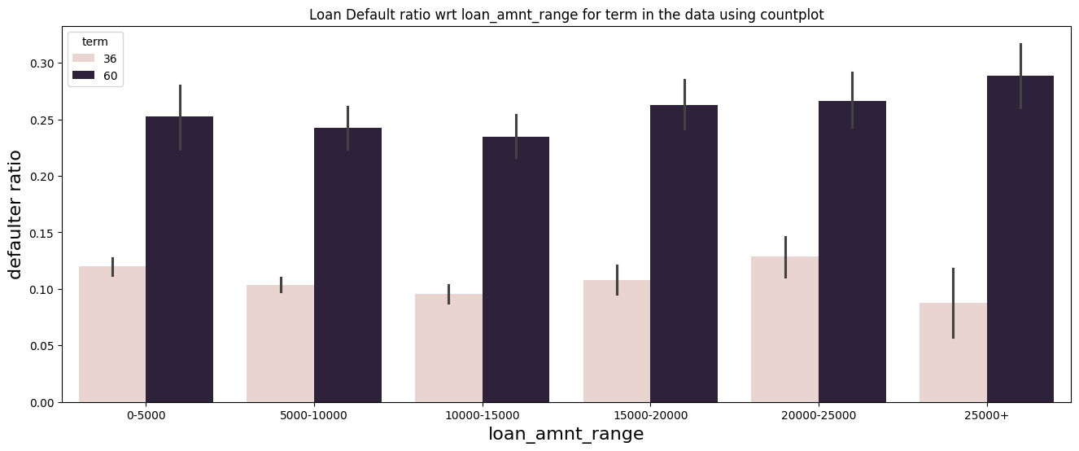
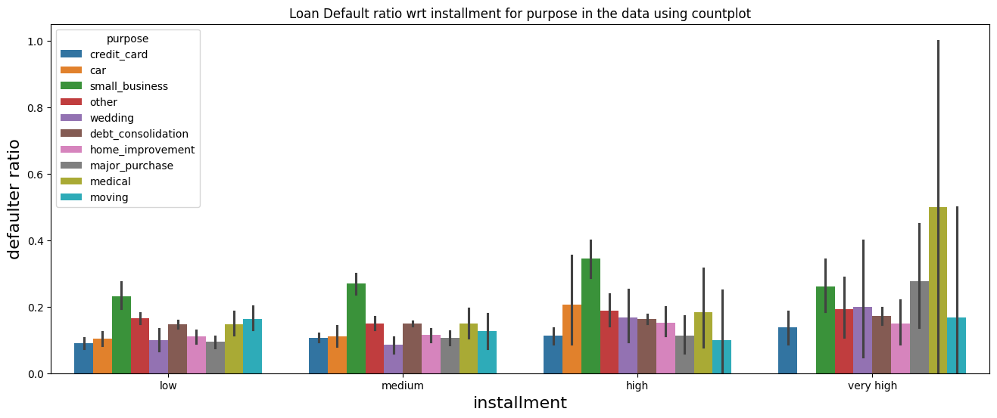
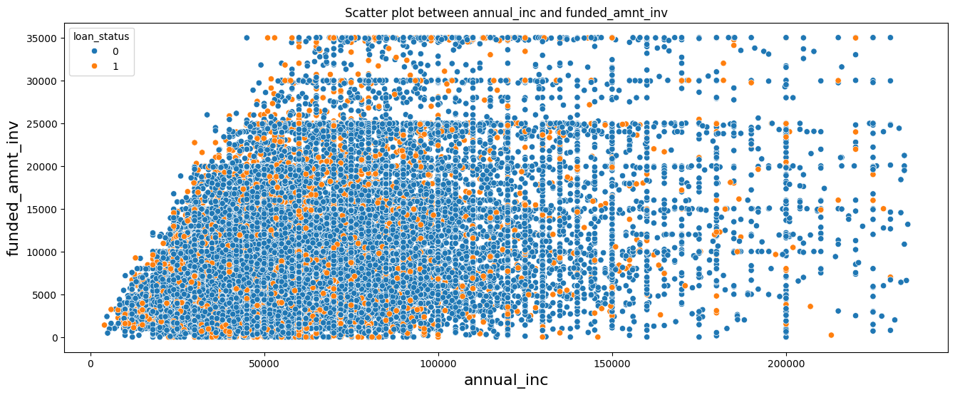
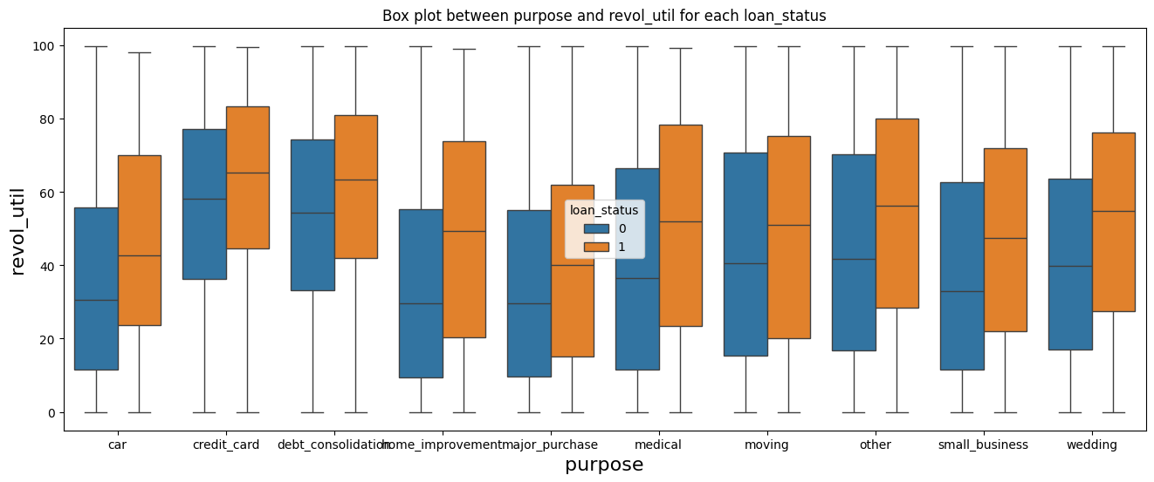
Bivariate Analysis

Slide 12
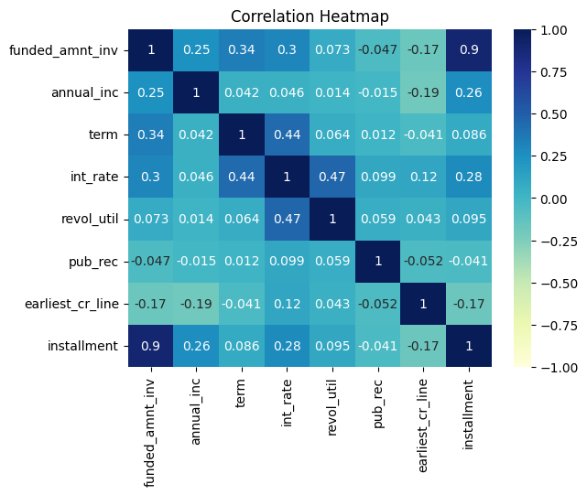
Multivariate Analysis

Slide 13
Inferences
Univariate Analysis
Defaulter rate is increasing with respect to term, grade, sub_grade, verification_status, pub_rec, pub_rec_bankruptcies, revol_util, loan_amnt, int_rate, installment.
Defaulter rate is decreasing with annual_inc.
We have seen that grade D, E, F, G has ~23% total loan however chances of being defaulted is also high here and cover 40% of total defaulters. Hence it makes sense to reject loans for borrowers in these three categories. Hence `grade` can become a deciding variable for loan approval.
Small_business has higher defaulter rate among other purposes.
Bivariate Analysis
medical purpose has highest tendency to default with installments > 800.
Multivariate Analysis
There is no stronger correlation with columns which greatly affects loan_status.

Slide 14
Result
As per dataset analysis, below variables can be driving factors for loan approval process
Term
Grade
Purpose
Revolving line utilization rate (revol_util)
Interest rate
Installment
Annual income
Public Record
Public Record for bankruptcies
Funded amount by investors

Slide 15
Recommendations
As per dataset analysis, below points might be considered for loan approval process
tendency to default is very high with borrowers having 2 bankruptcies.
Implement Stricter Criteria for Grades E, F and G, they increase tendecy to default.
Evaluate and Limit 60-Month Loans
Review Verification Process as from dataset it is observed that verified loans are more defaulted which should be otherwise.
Adjust Interest Rates Based on DTI Ratios
Consider Annual Income Levels for Affordability

Slide 16
Team
Raman Pandey
Rajeev Ranjan

